Slide 1
Collection
29-sep-2020

Slide 2
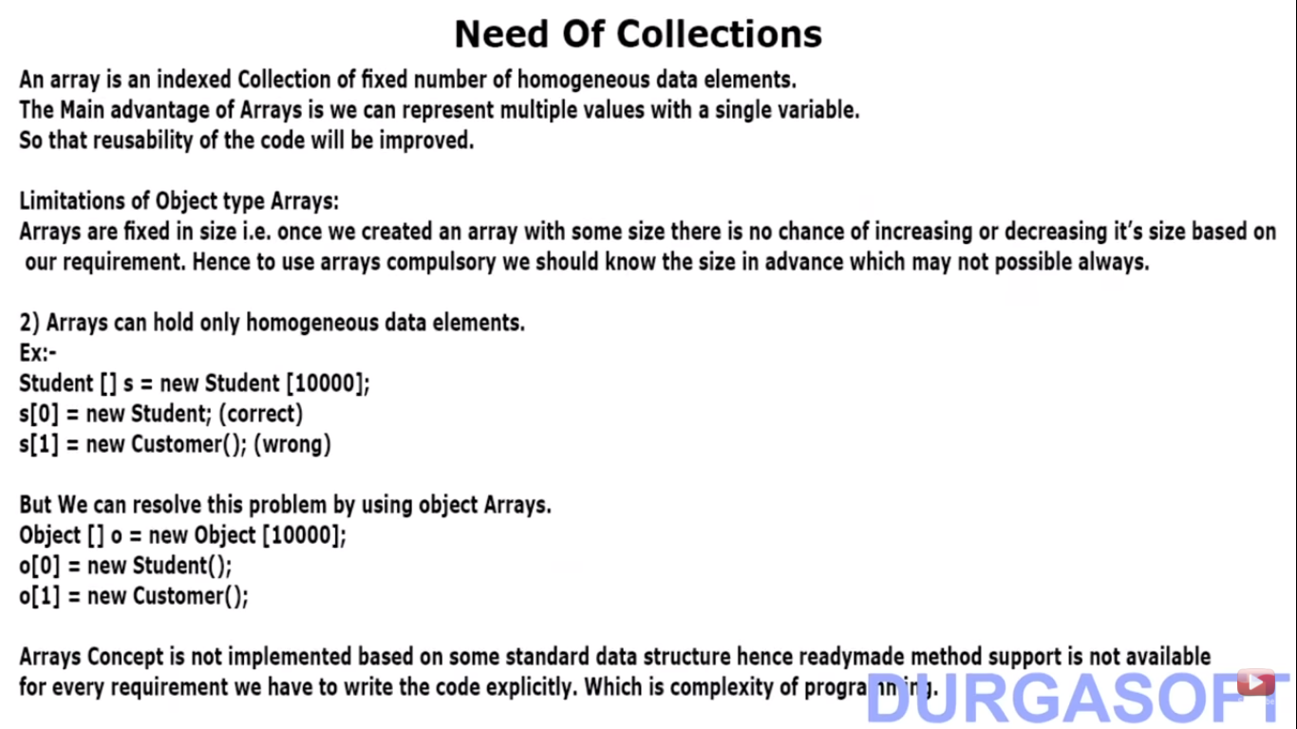

Slide 3
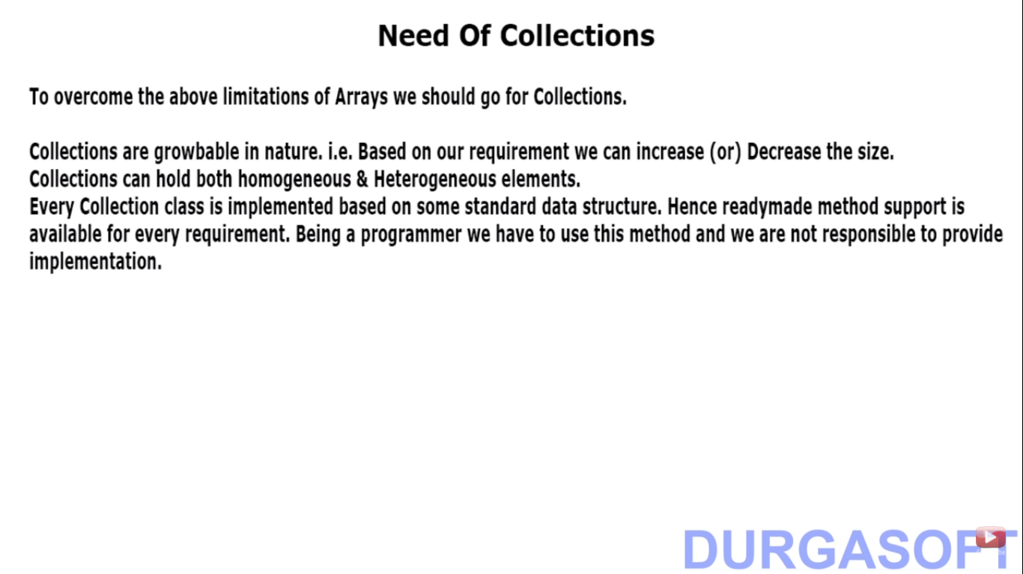

Slide 4
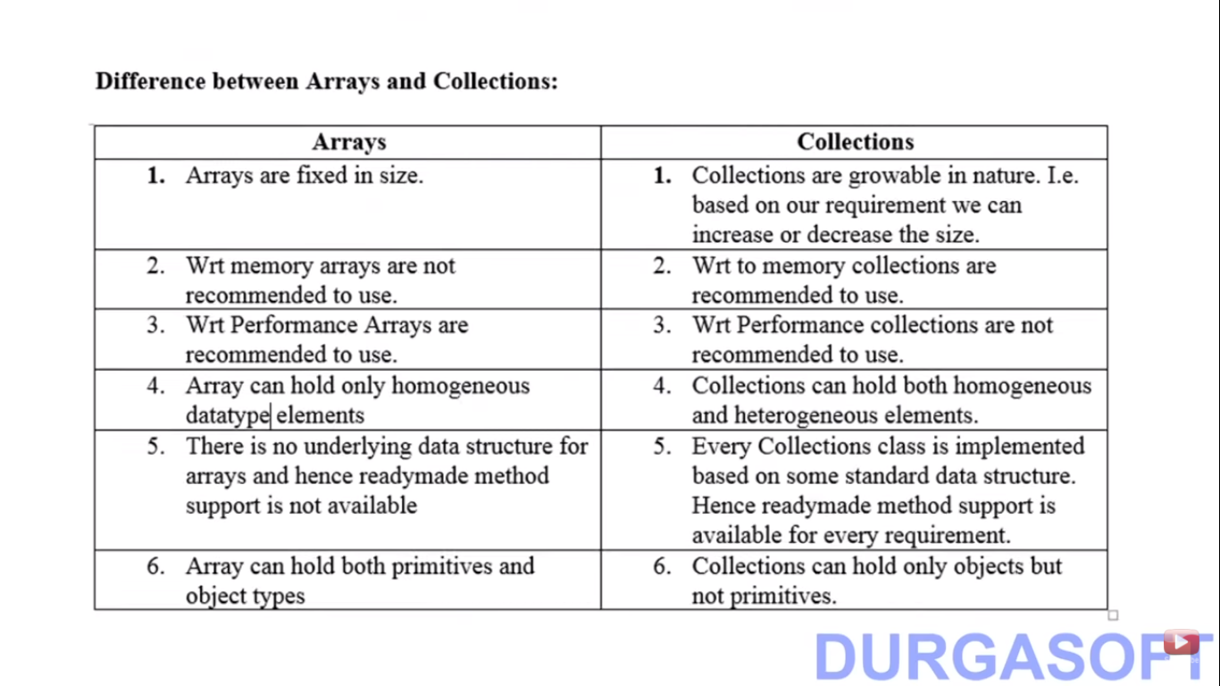

Slide 5
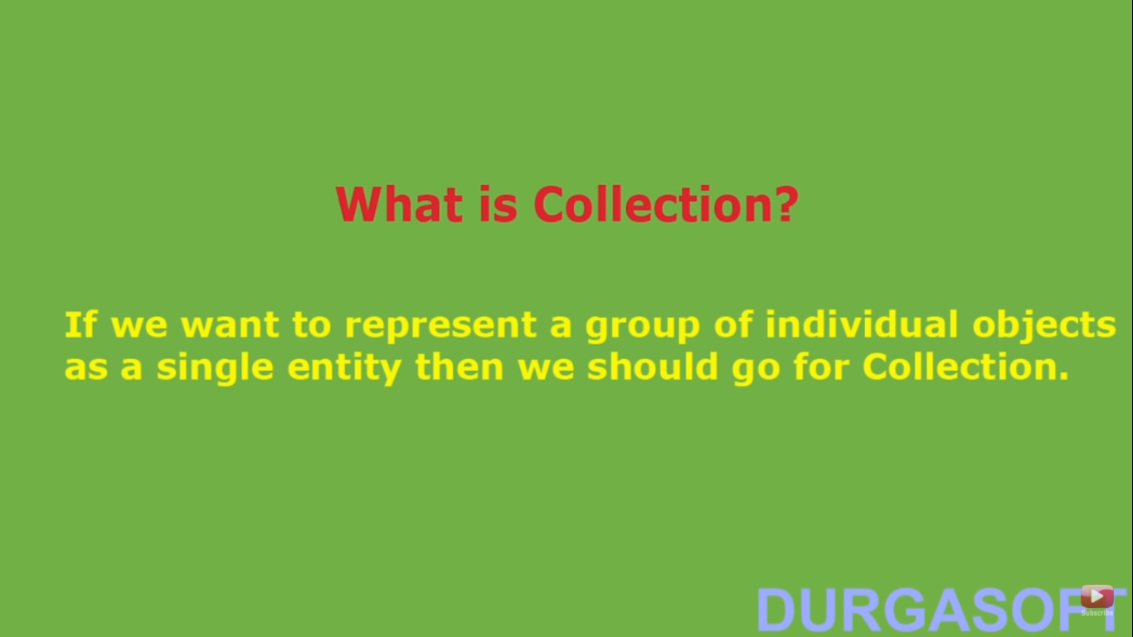
Collection

Slide 6
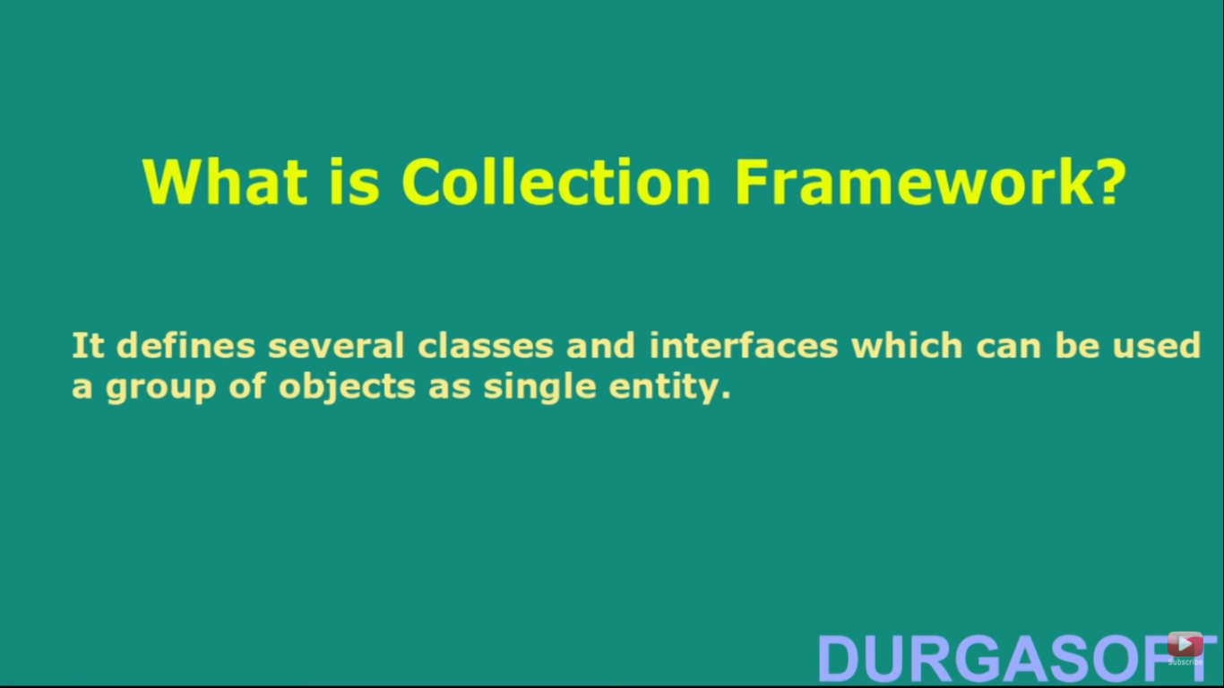
Collection Framework

Slide 7
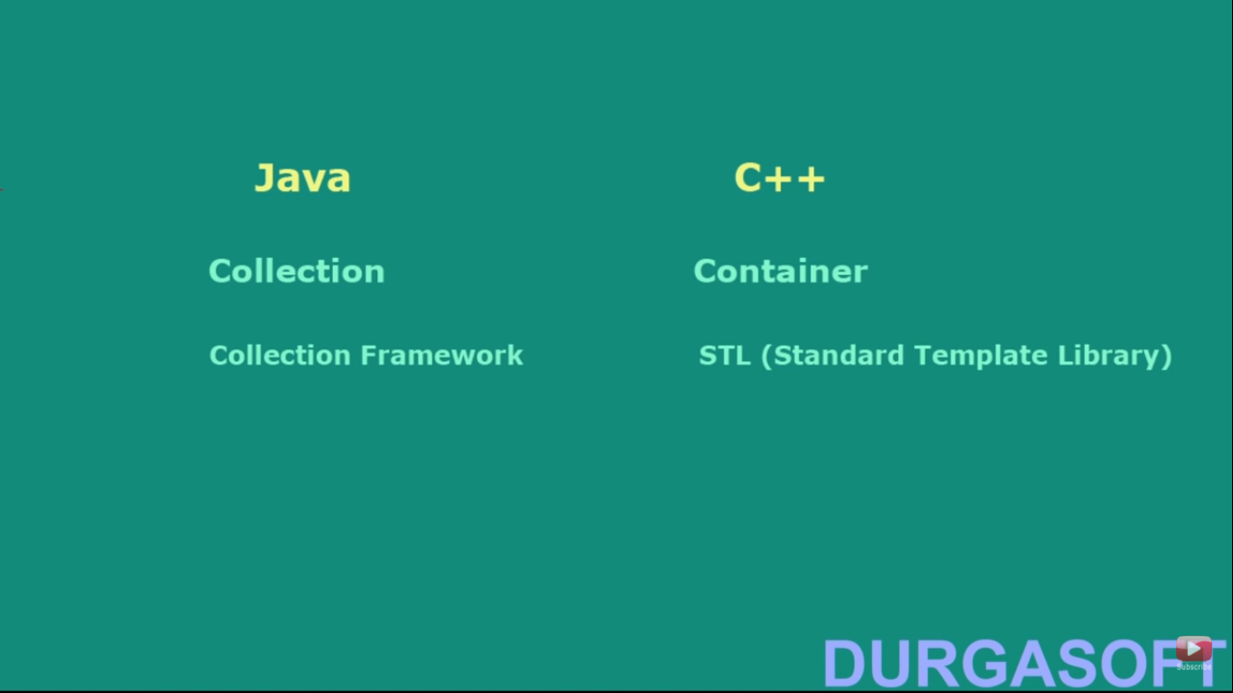
Java & CPP difference

Slide 8
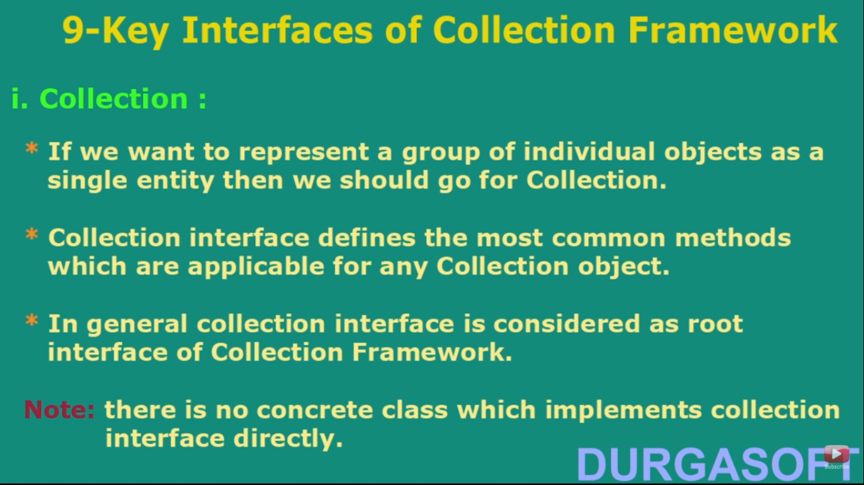
Collection

Slide 9
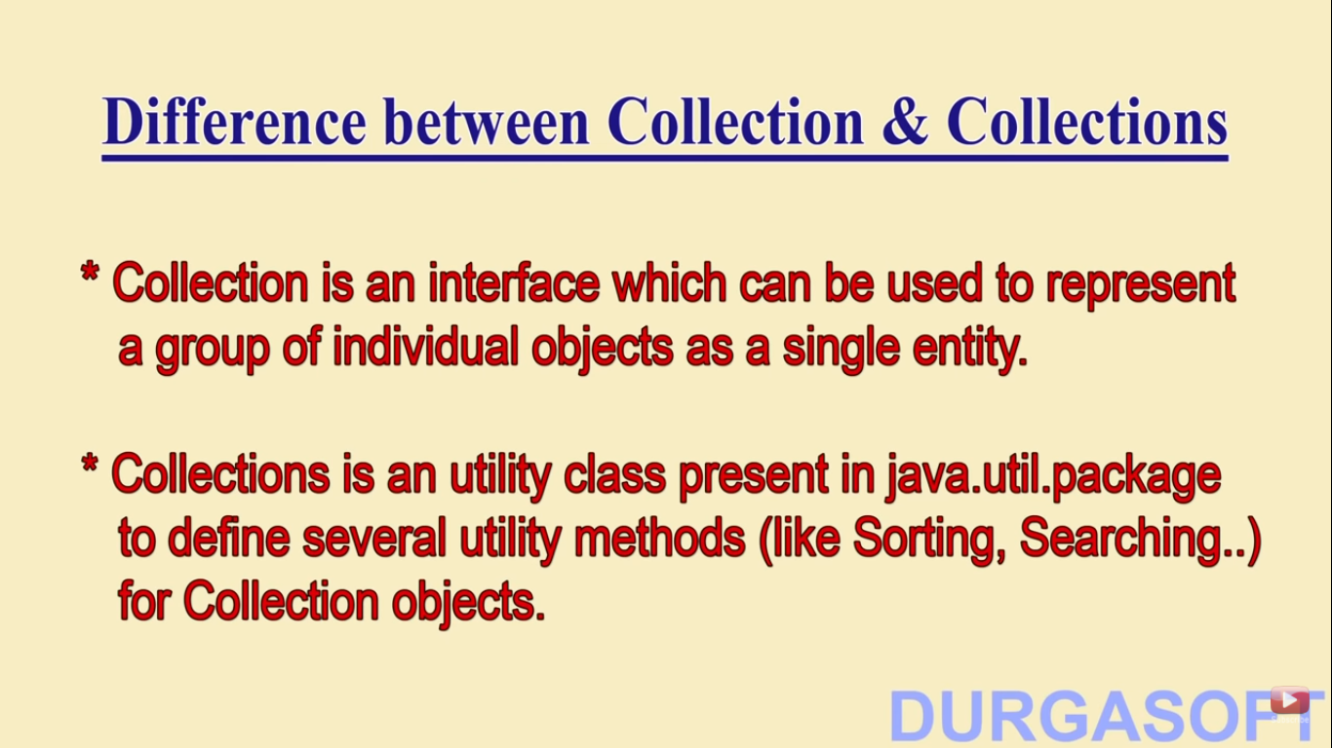
Diff btw Collection & collections

Slide 10
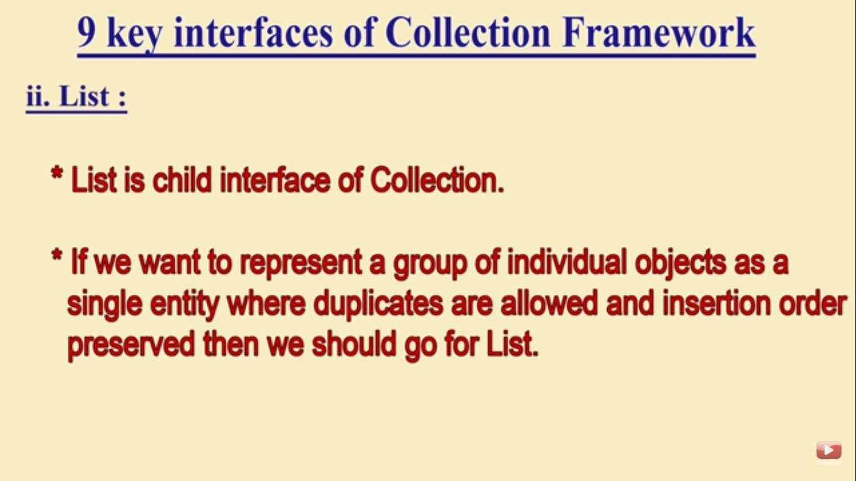
List

Slide 11
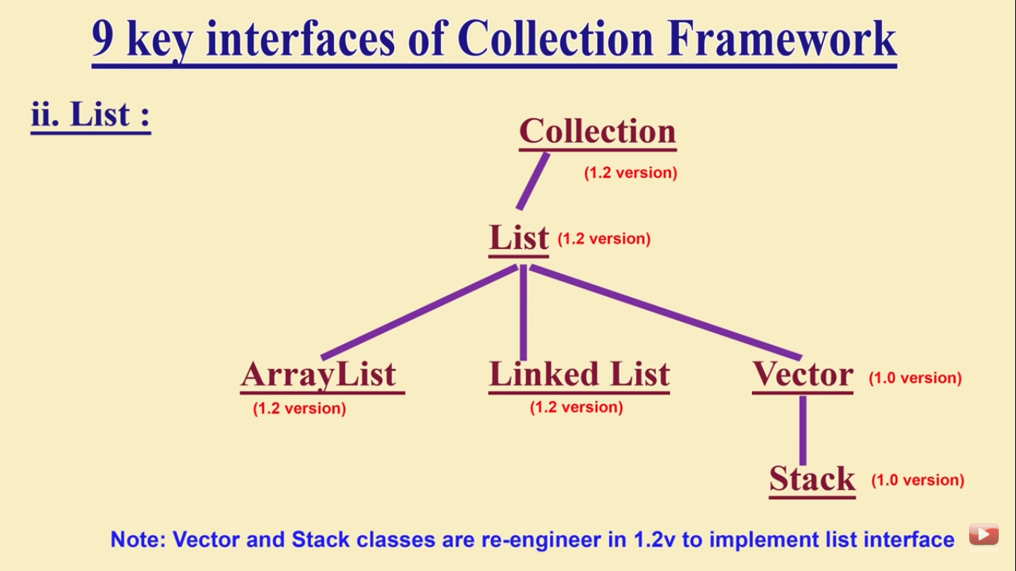
List diagram

Slide 12
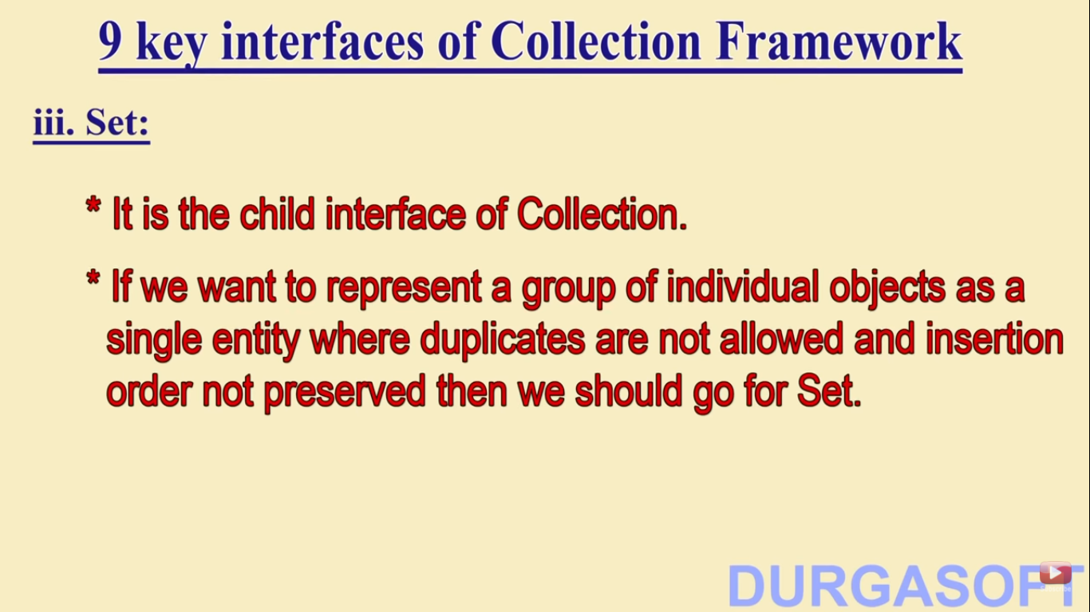
Set

Slide 13
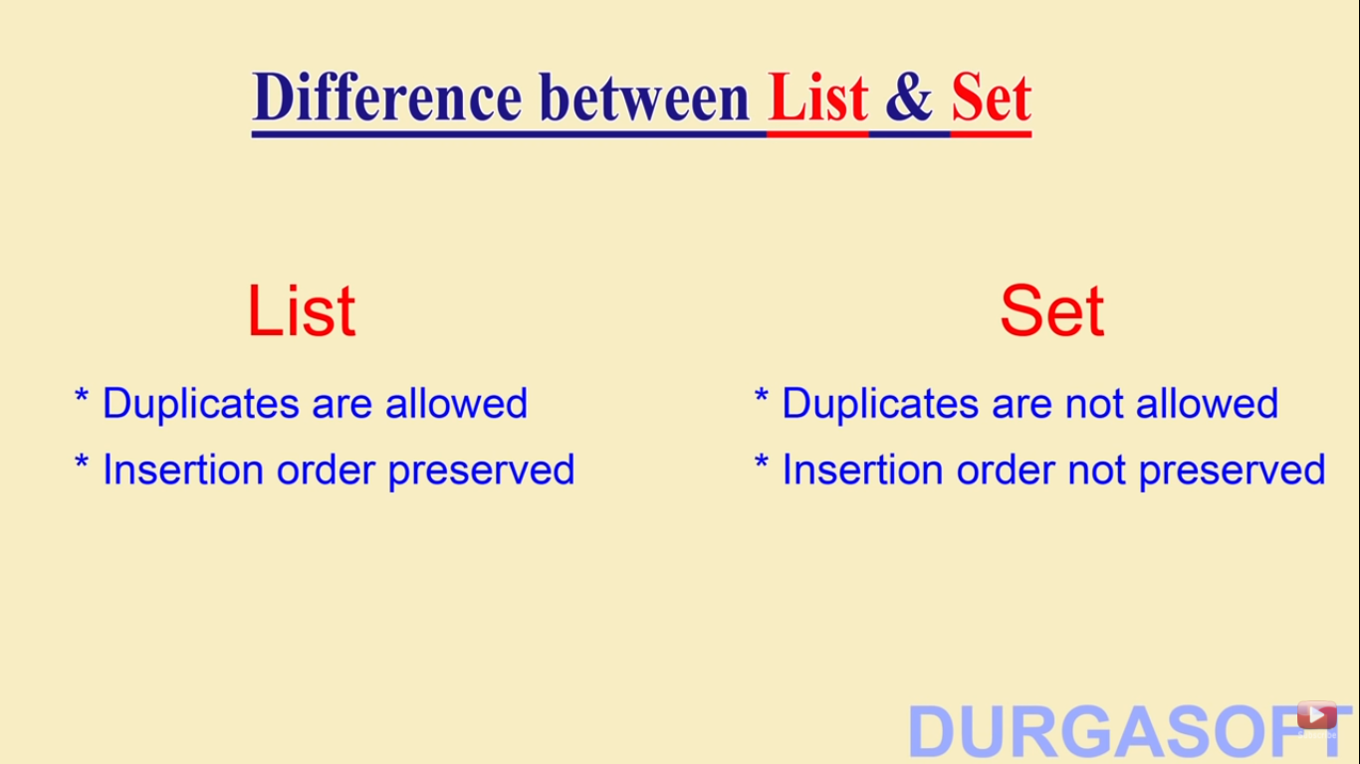
Dif btw list & set

Slide 14
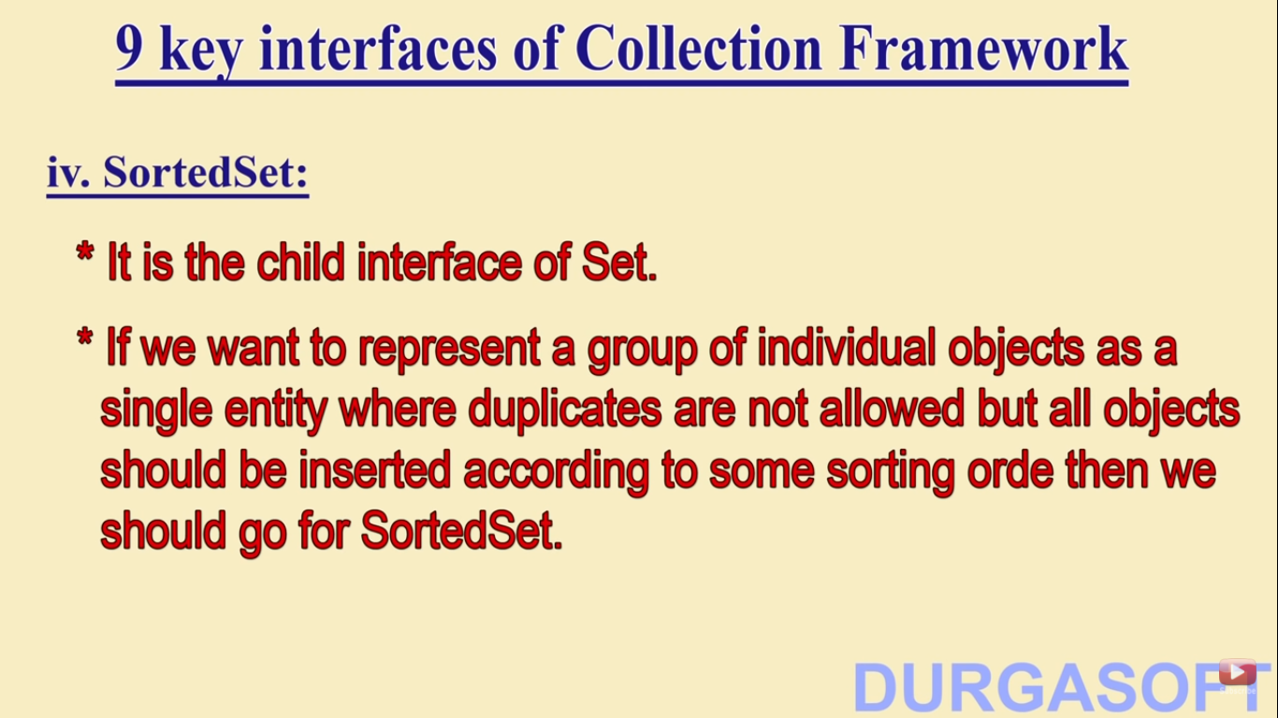
SortedSet

Slide 15
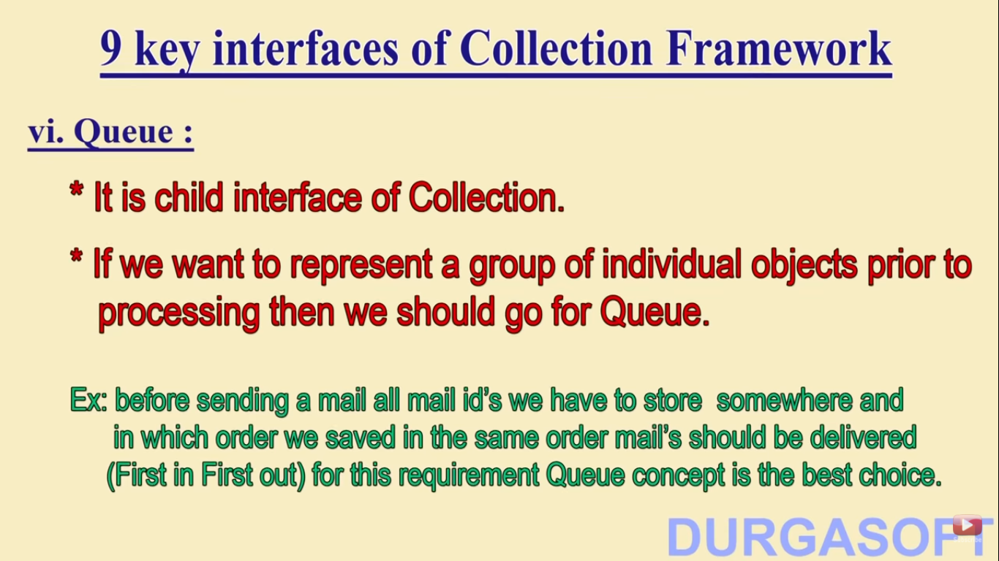
Queue

Slide 16
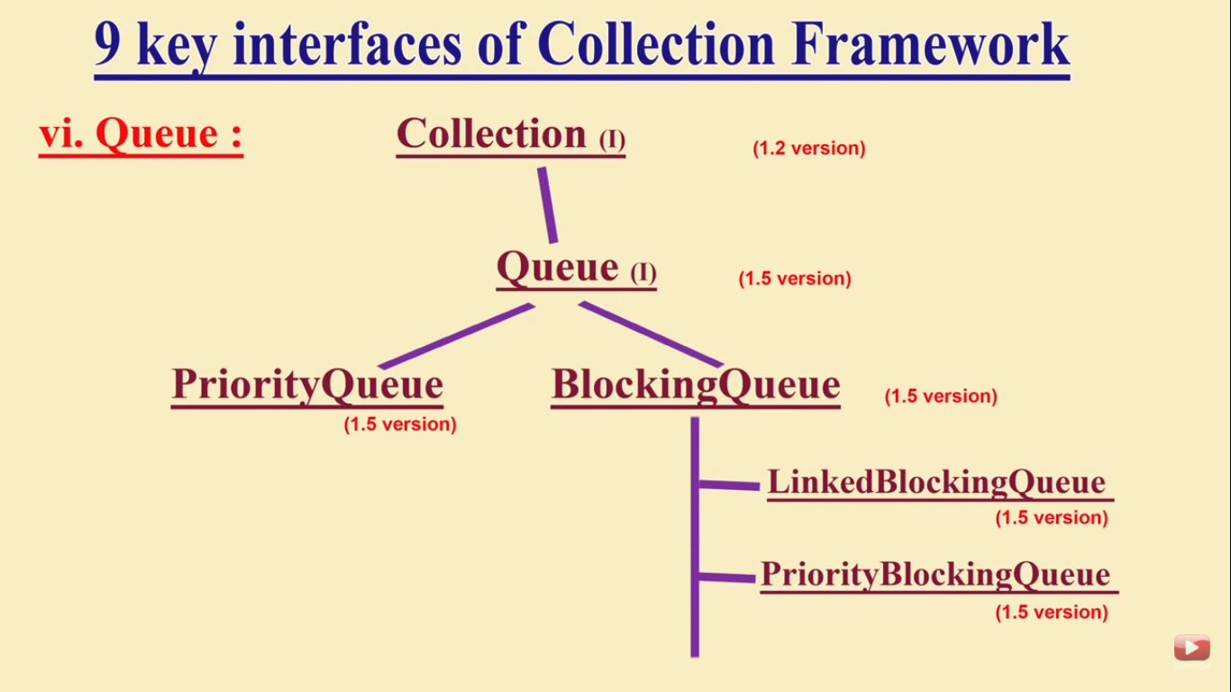
Queue Diagram

Slide 17
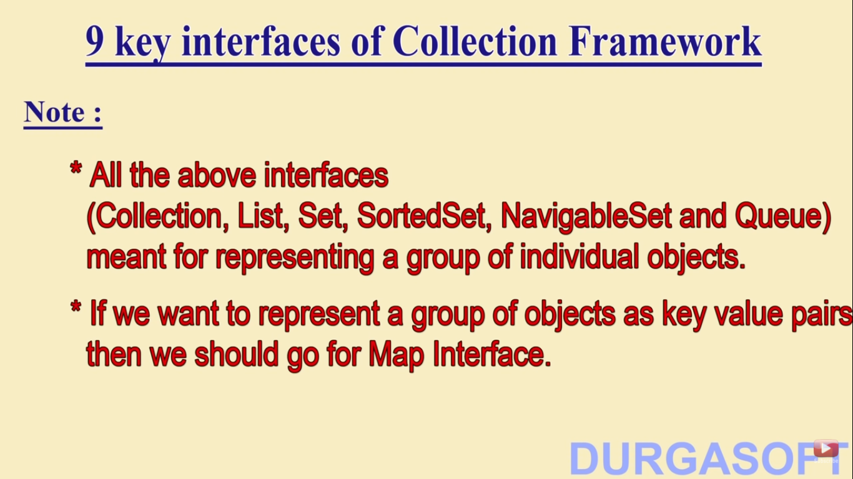
Notes

Slide 18
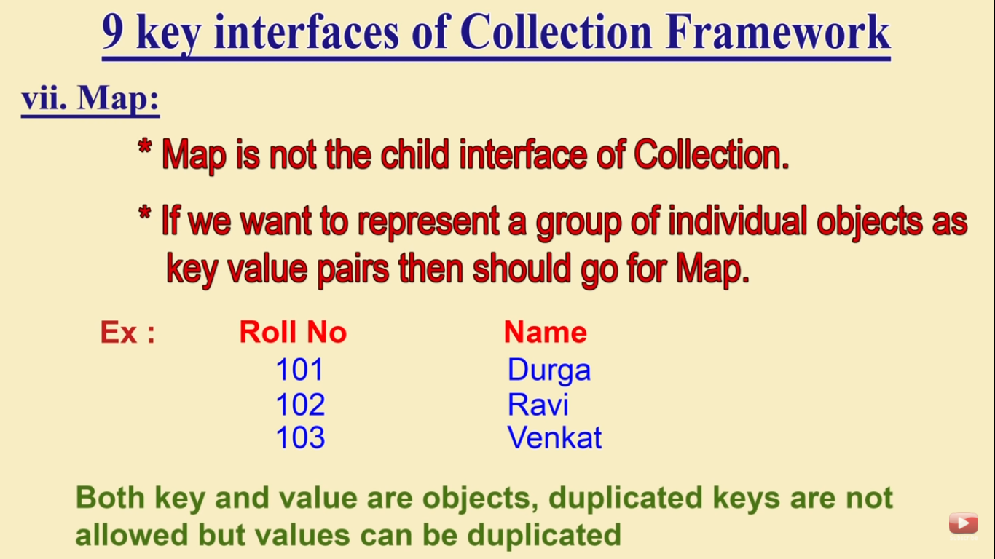
Map

Slide 19
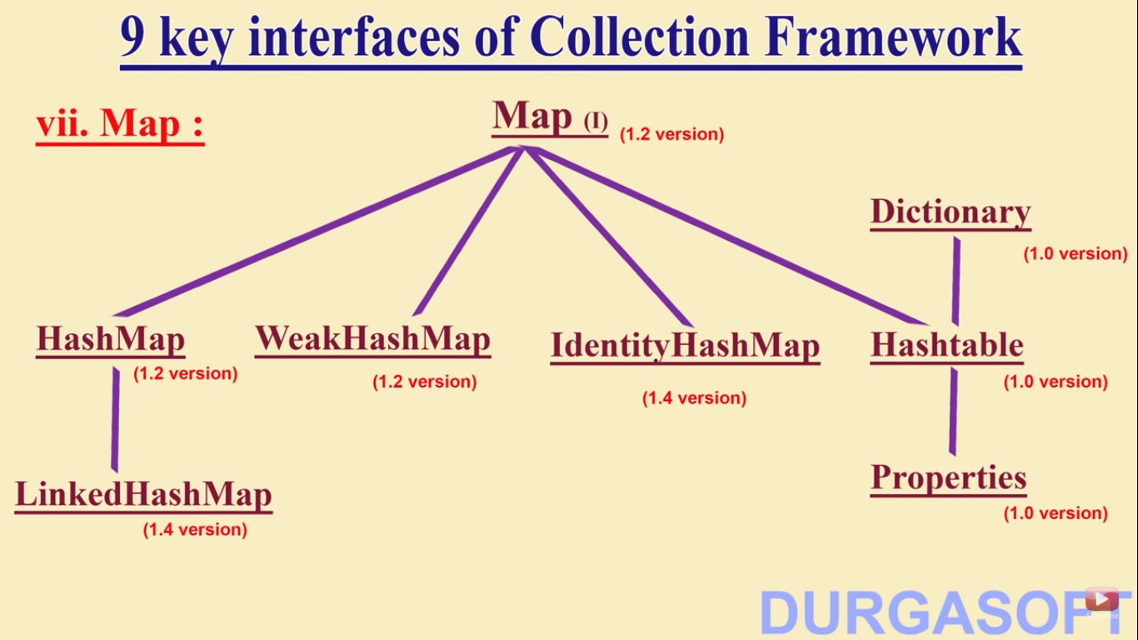
Map Diagram

Slide 20
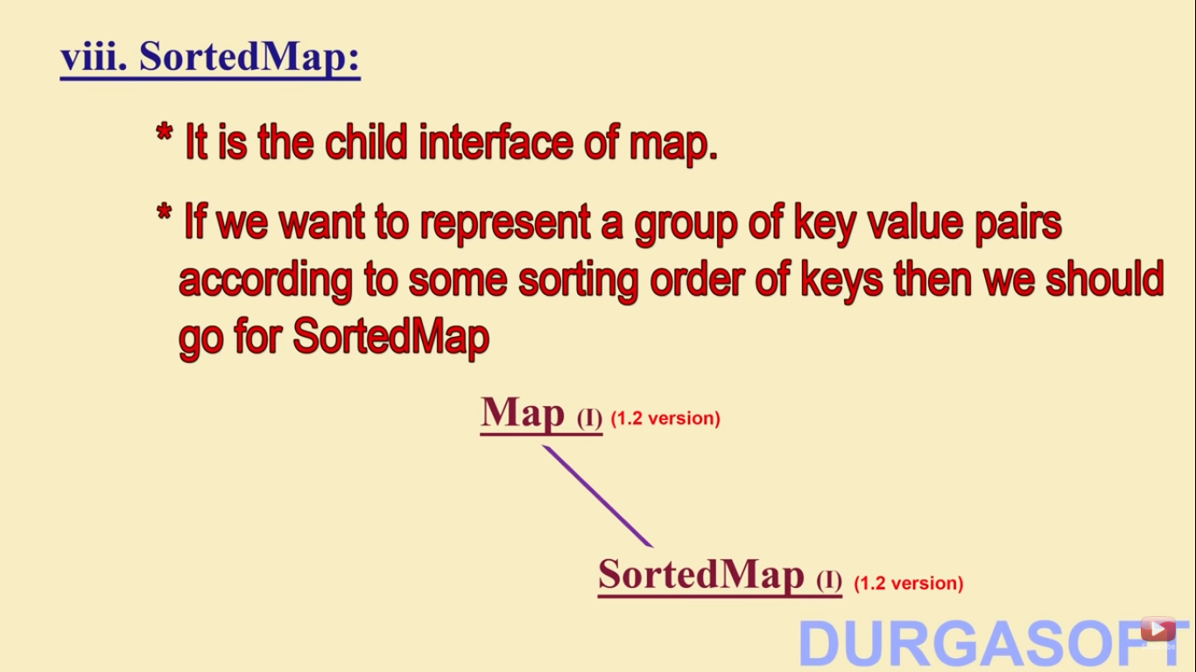
SortedMap

Slide 21
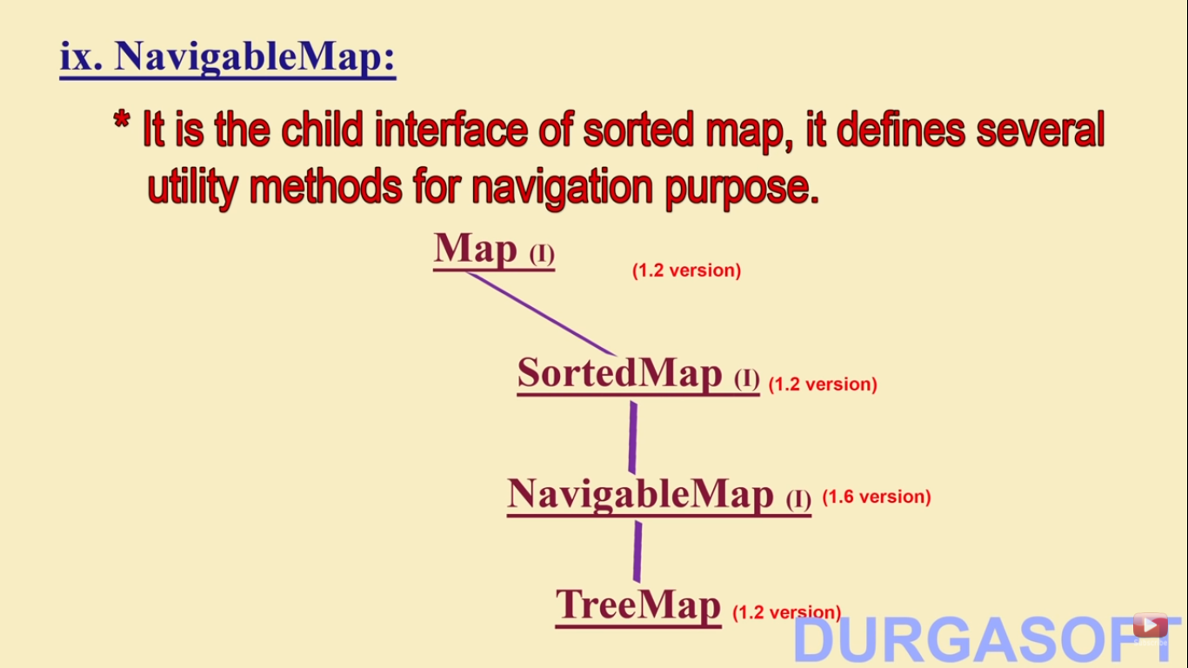
NavigableMap

Slide 22
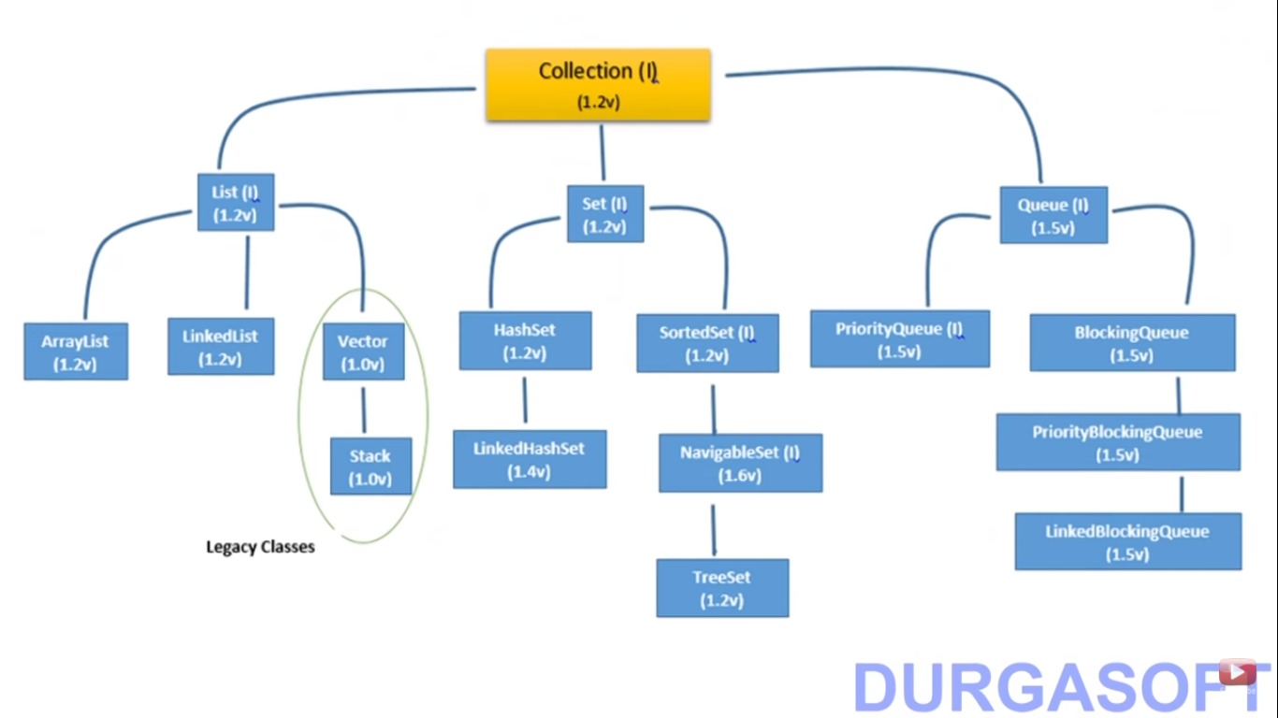
Collection Hierarchy

Slide 23
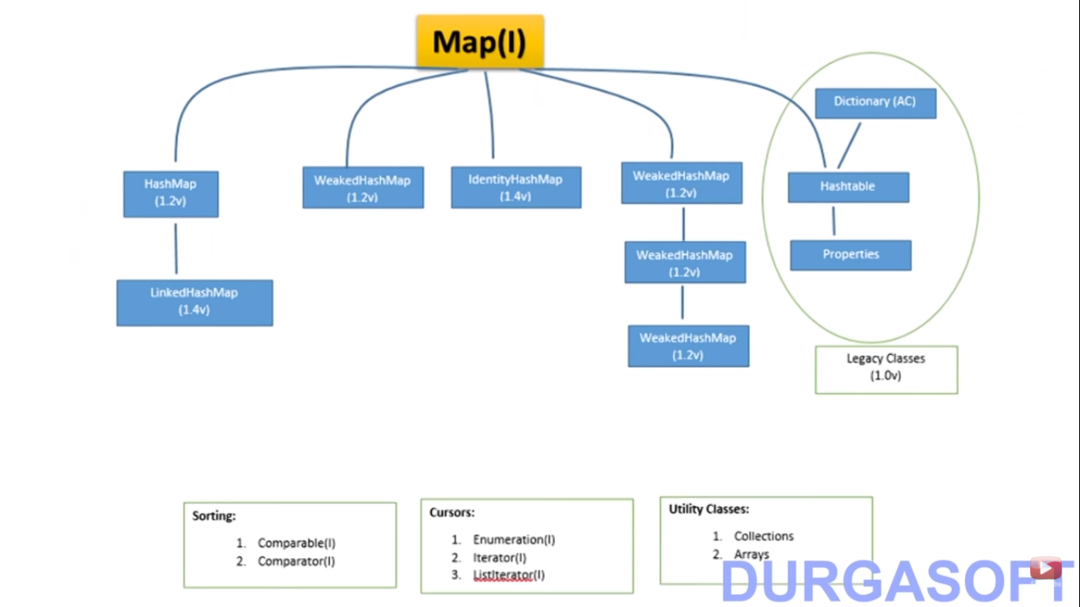

Slide 24
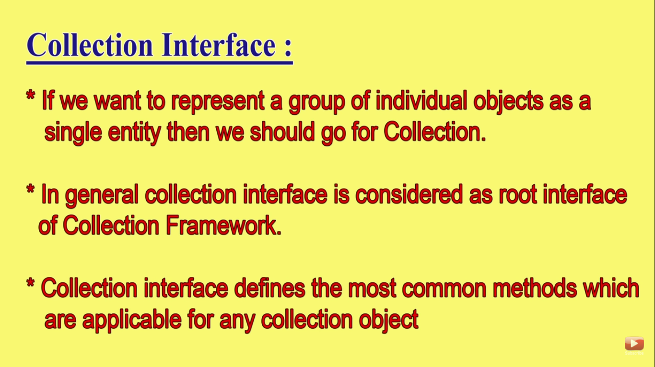

Slide 25
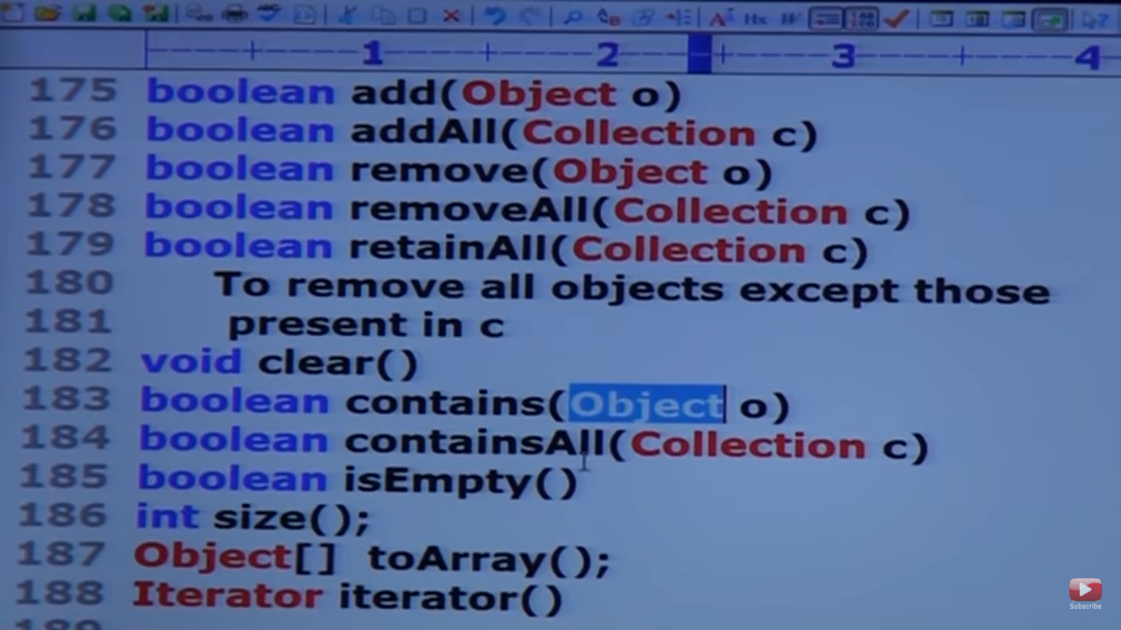

Slide 26
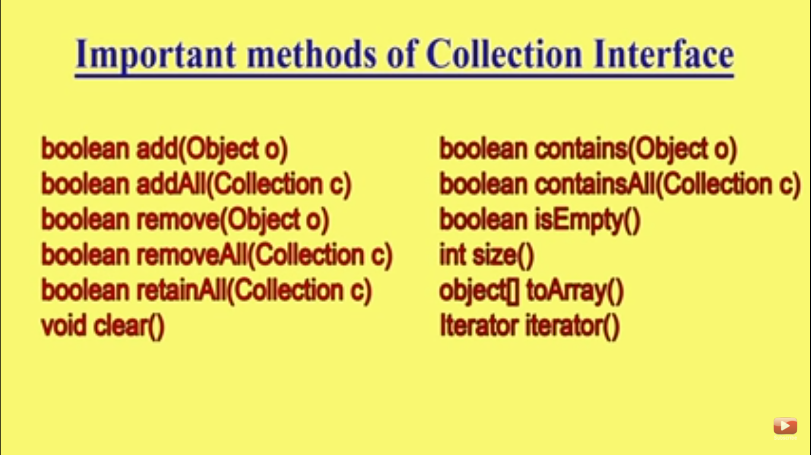

Slide 27
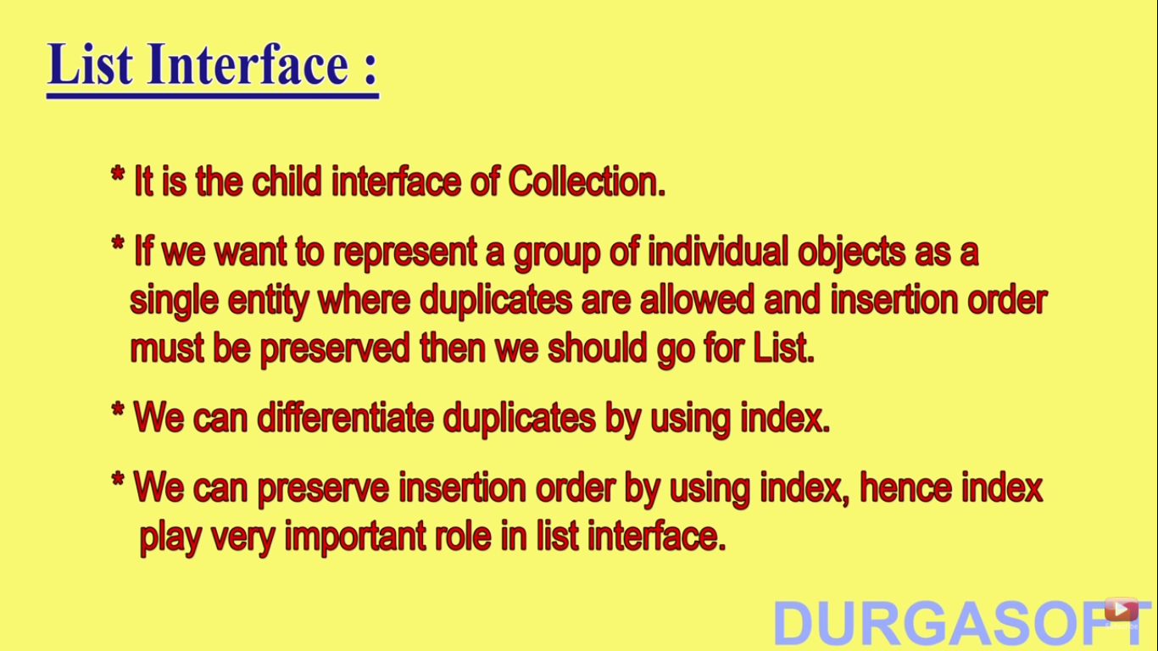
List interface

Slide 28
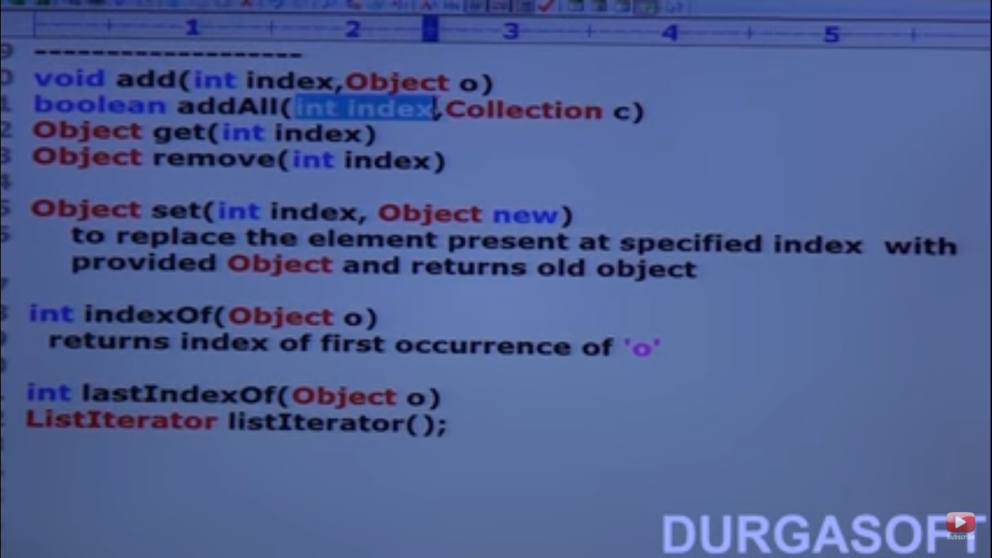
Program

Slide 29
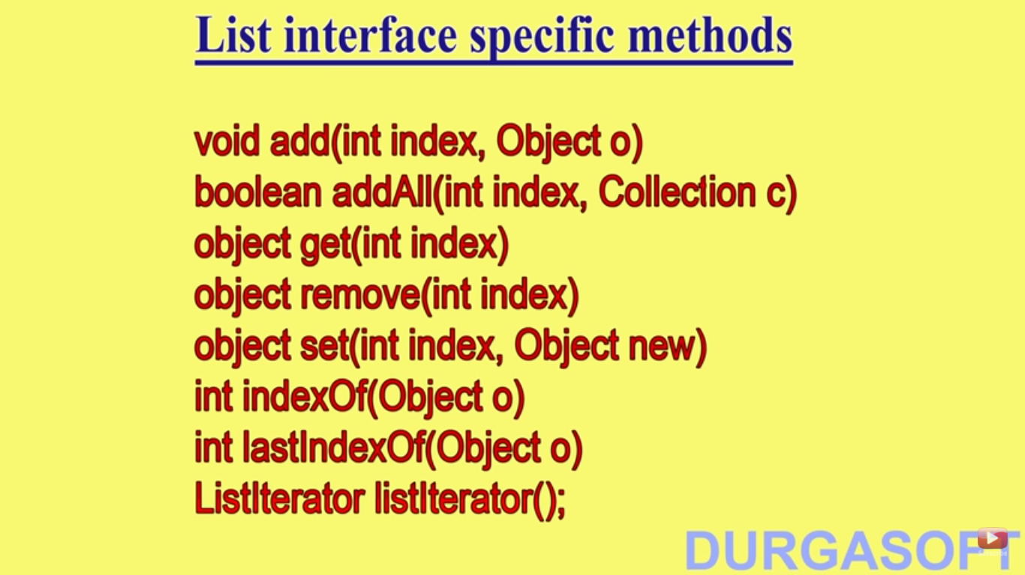
Method in list interface

Slide 30
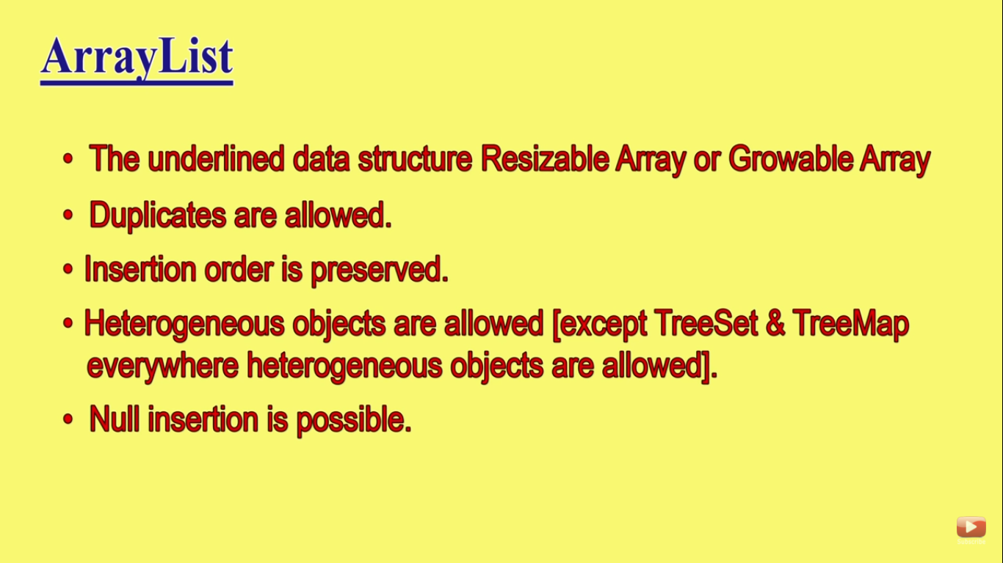
Arrat list

Slide 31
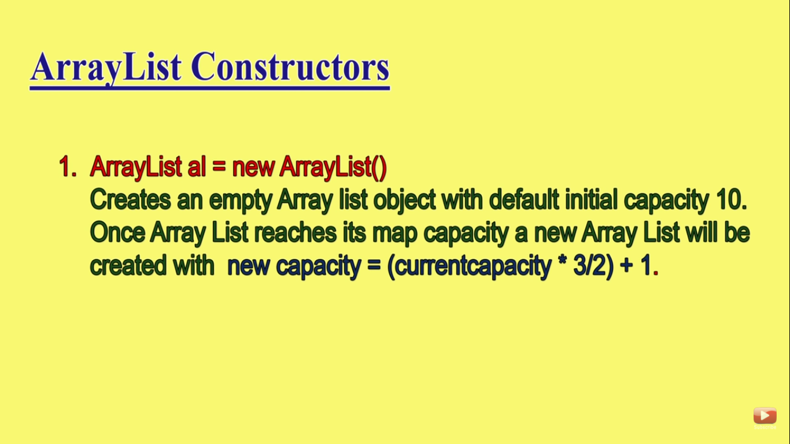
Constructors in arraylist

Slide 32
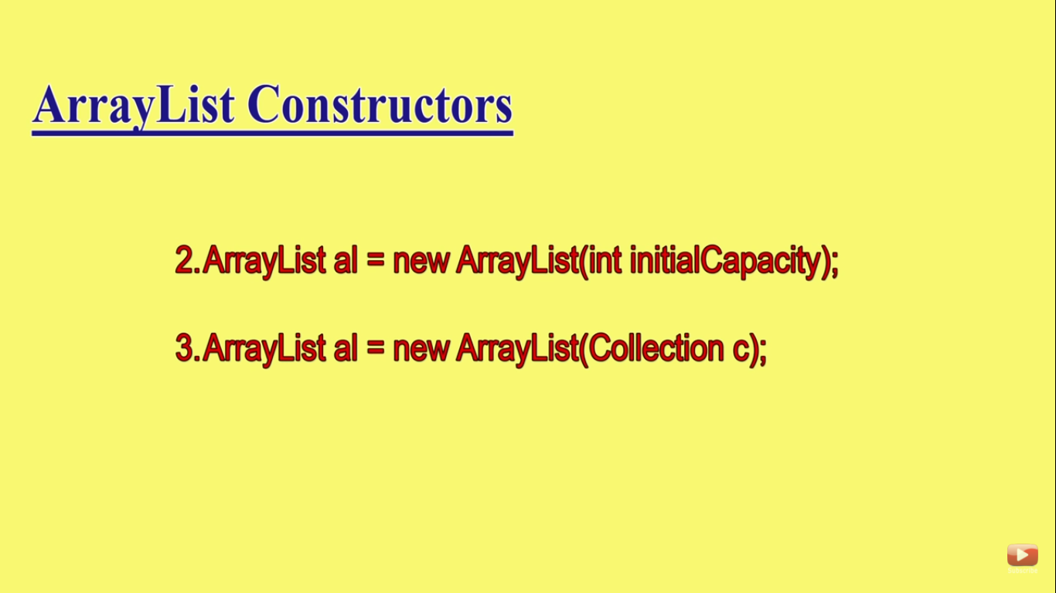
Constructor in arraylist

Slide 33
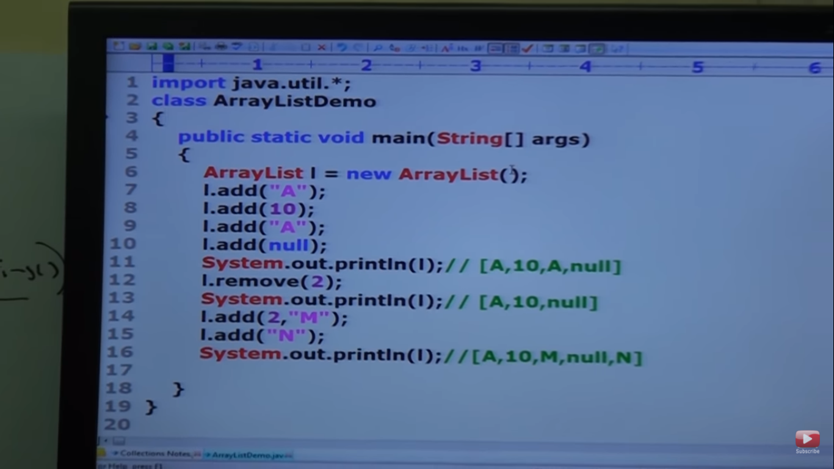
Proggram

Slide 34
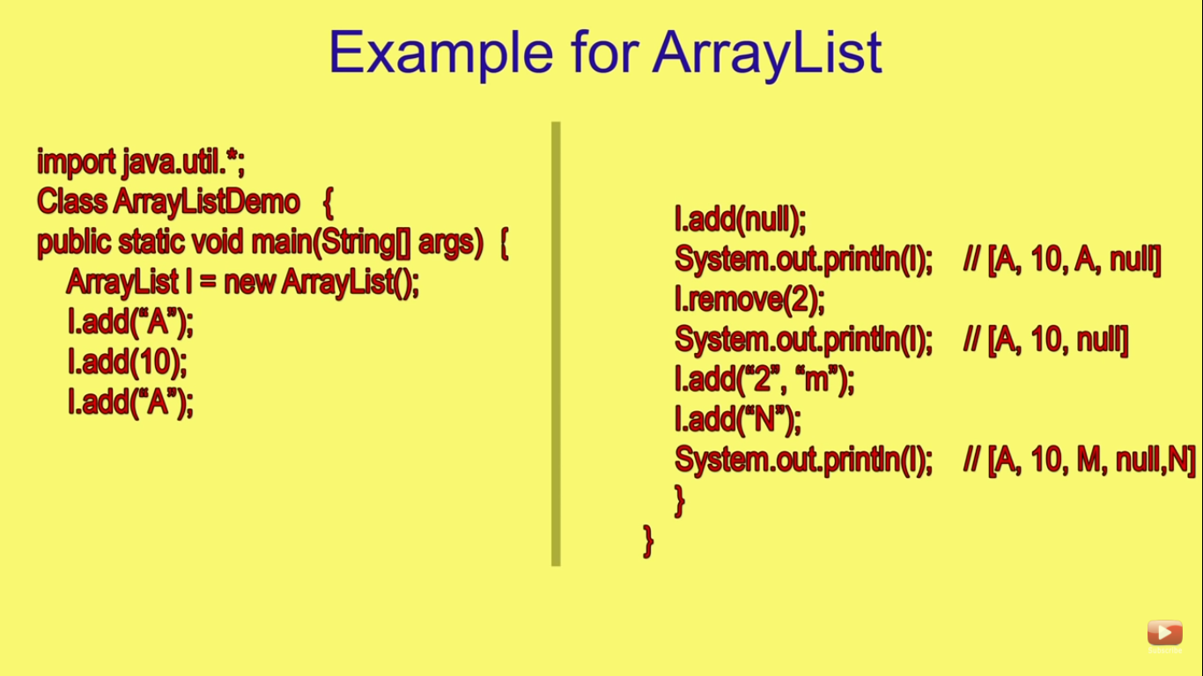
Arraylist

Slide 35
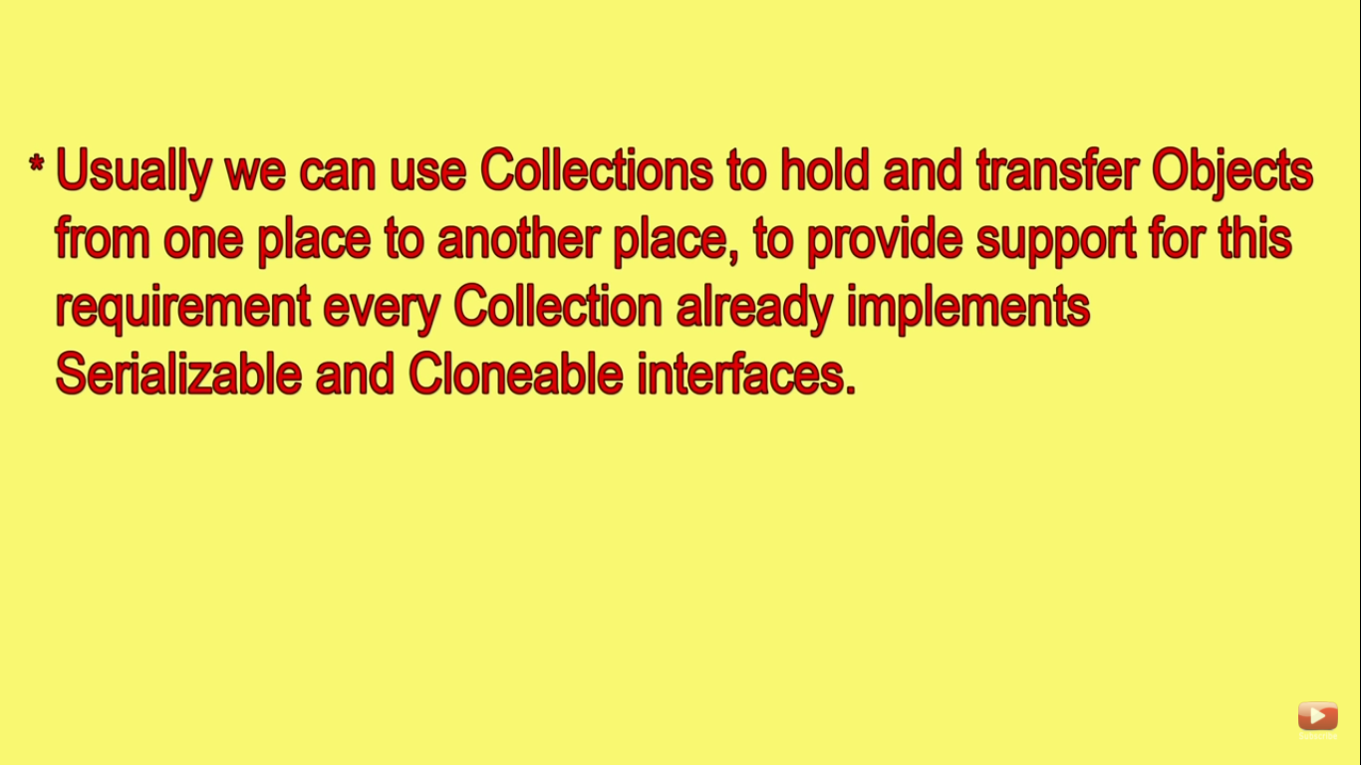

Slide 36
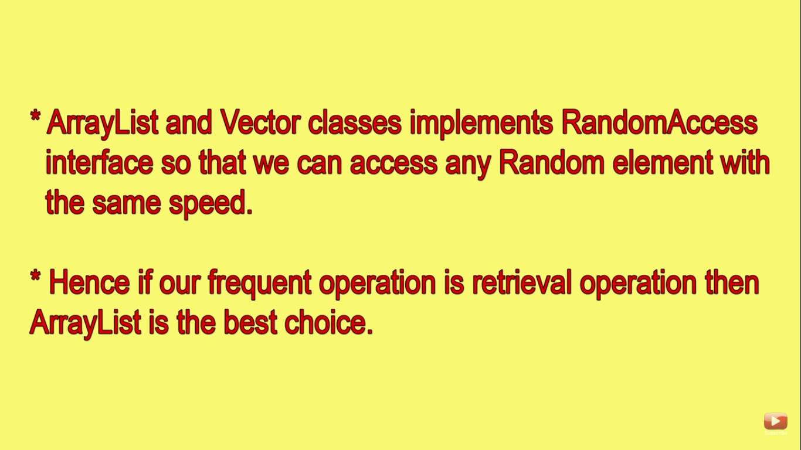
Notes

Slide 37
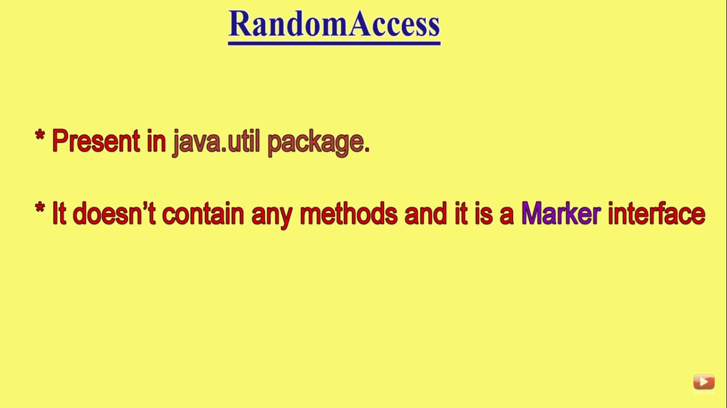
Random access

Slide 38
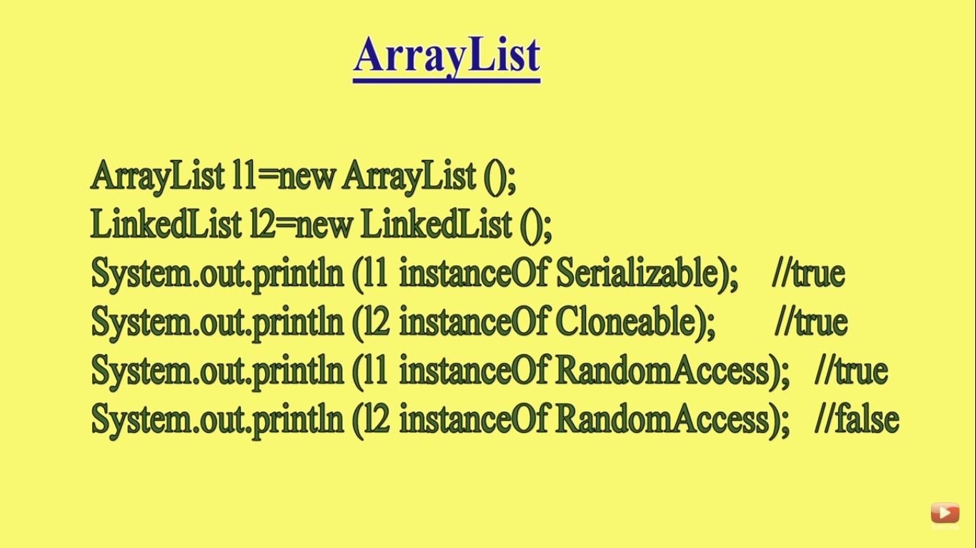

Slide 39
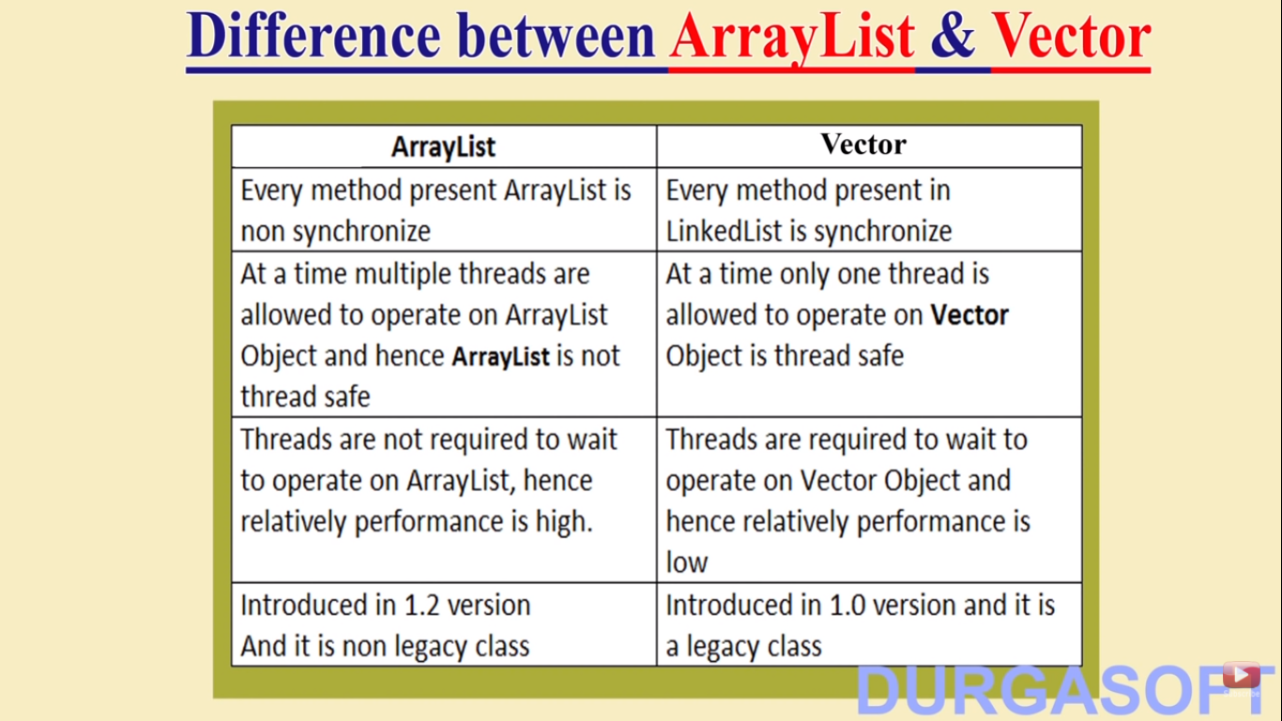

Slide 40
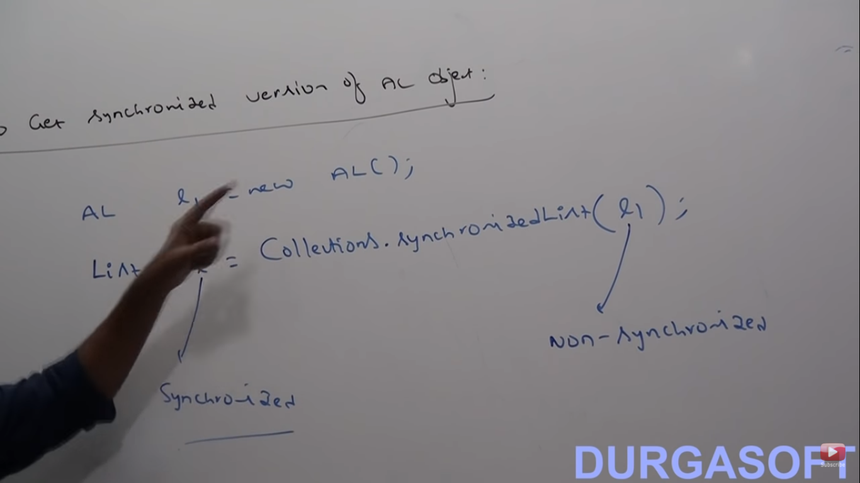
list

Slide 41
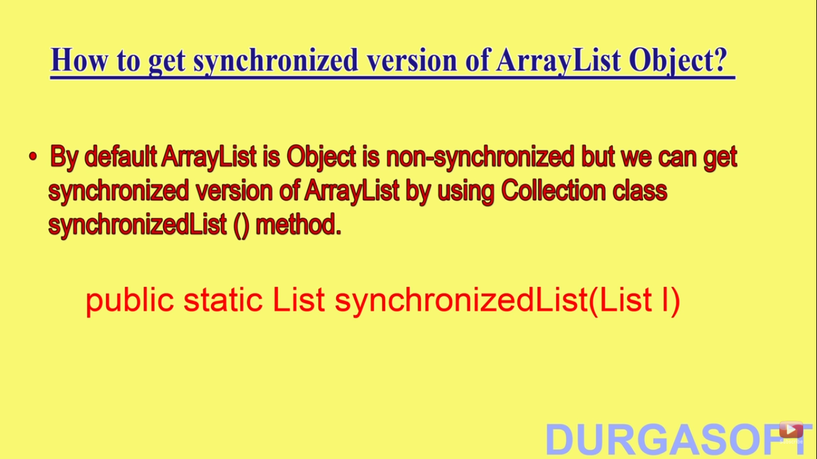

Slide 42
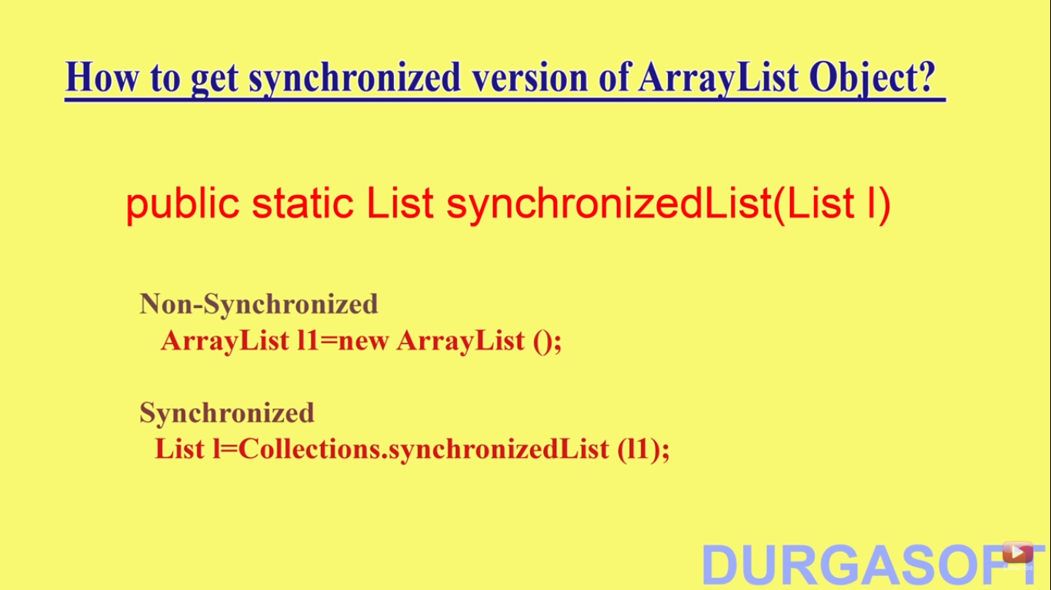

Slide 43
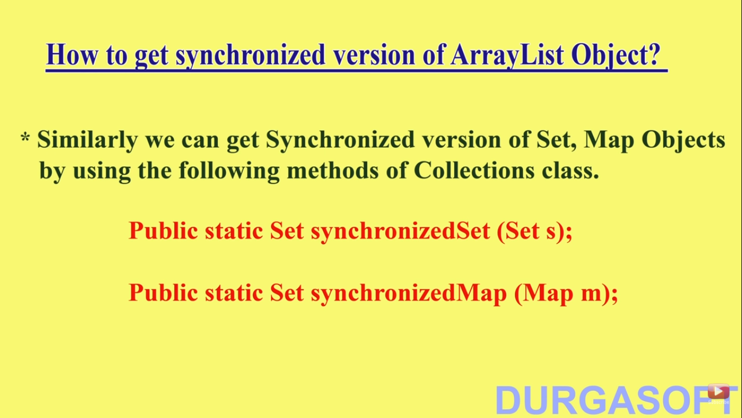

Slide 44
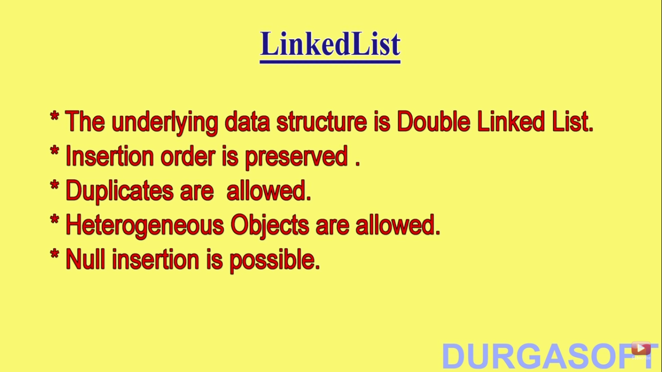
Linkedlist

Slide 45
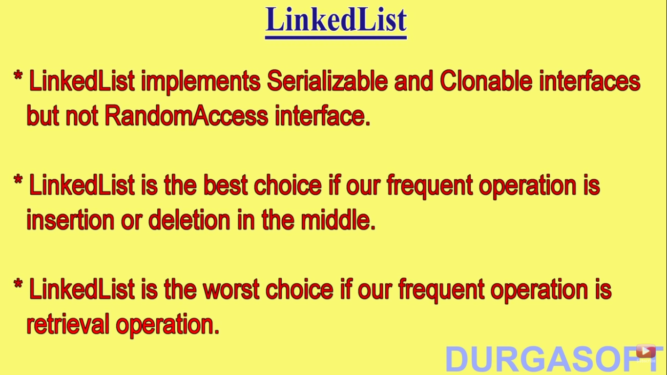

Slide 46
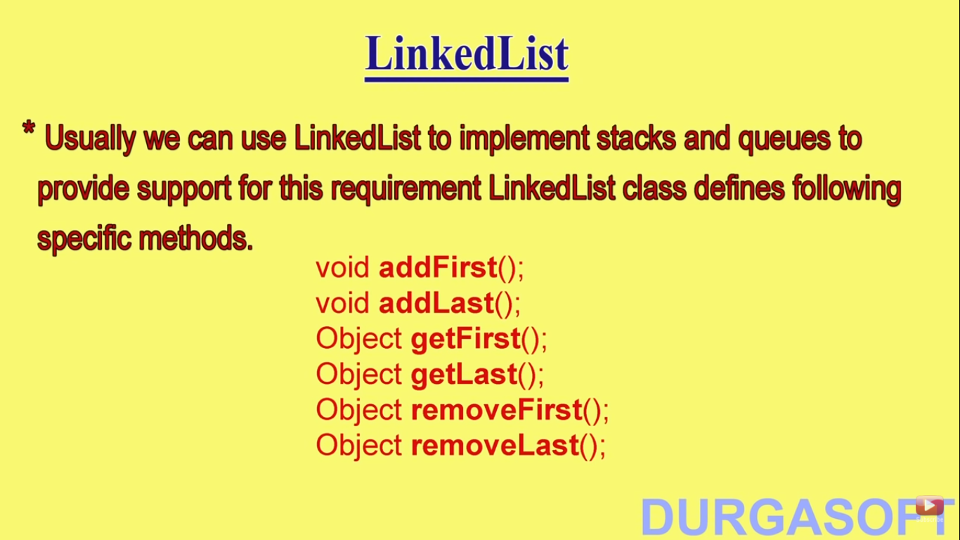

Slide 47
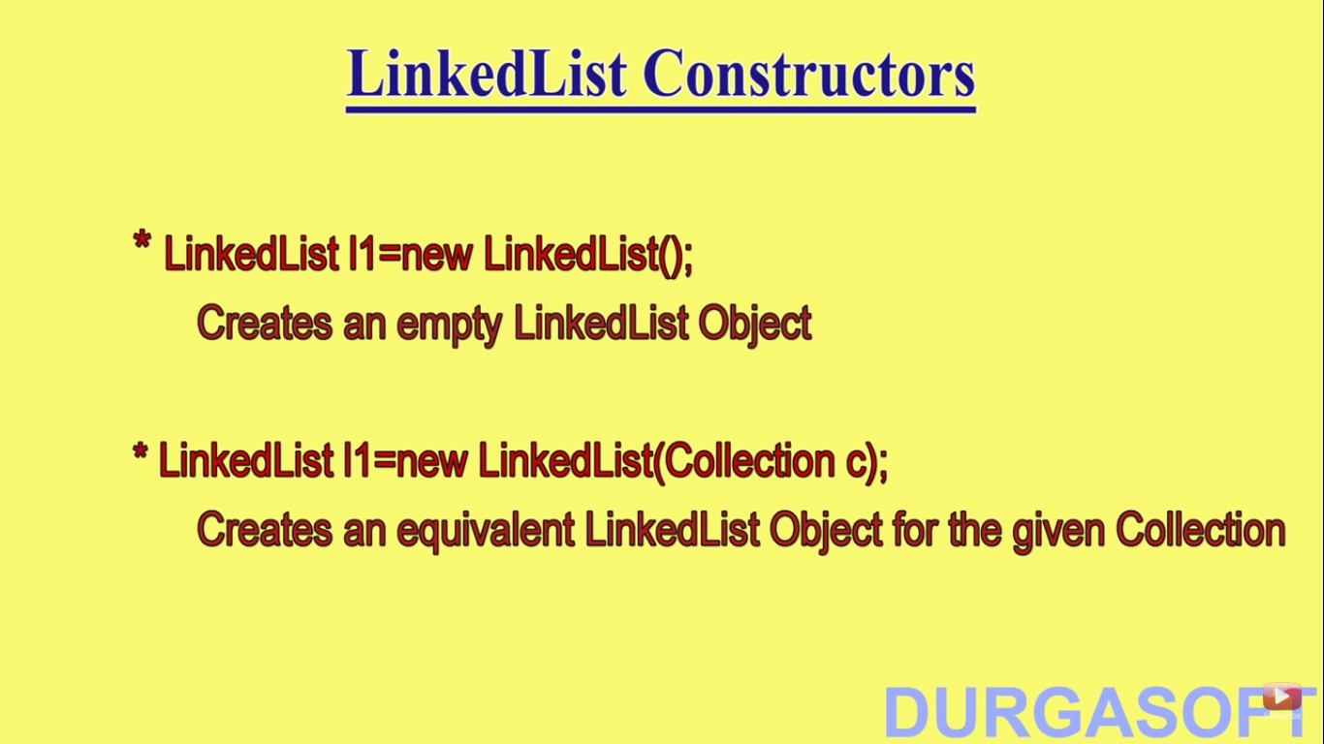
Linkedlist constructor

Slide 48
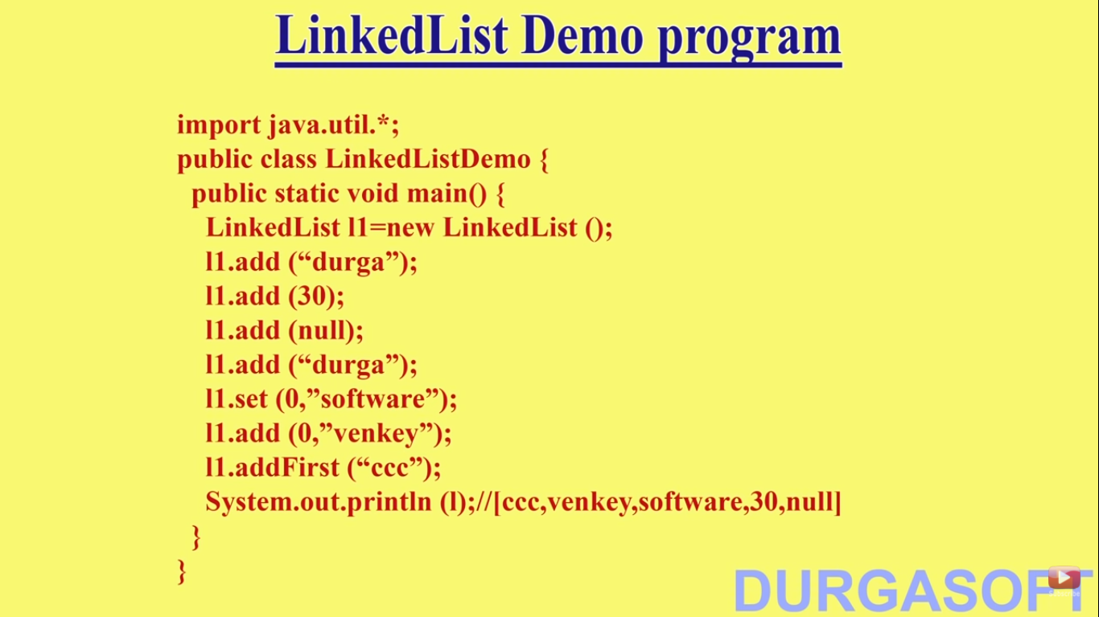

Slide 49
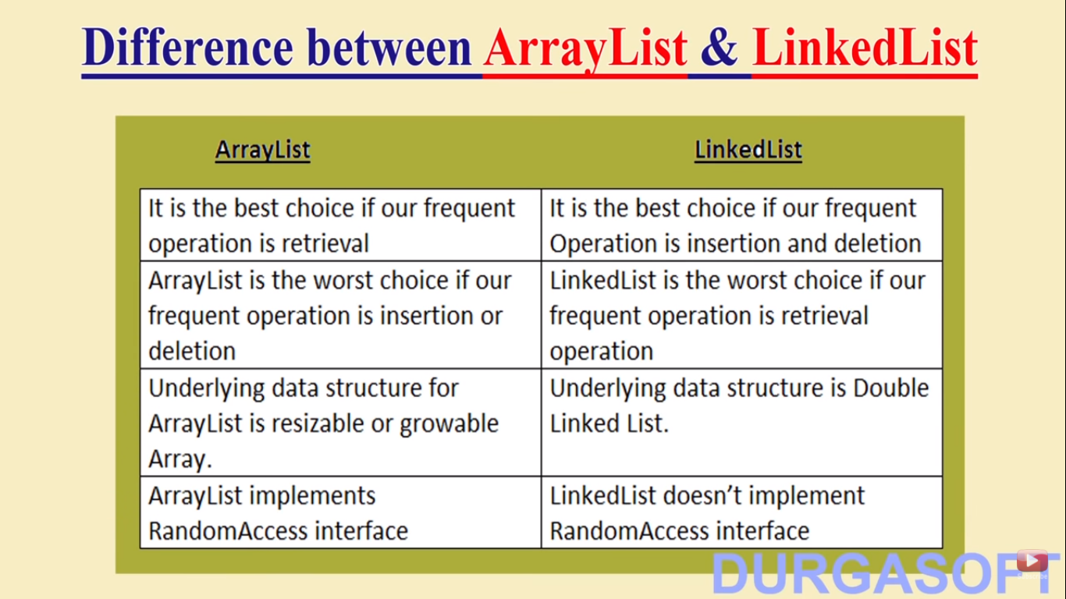

Slide 50
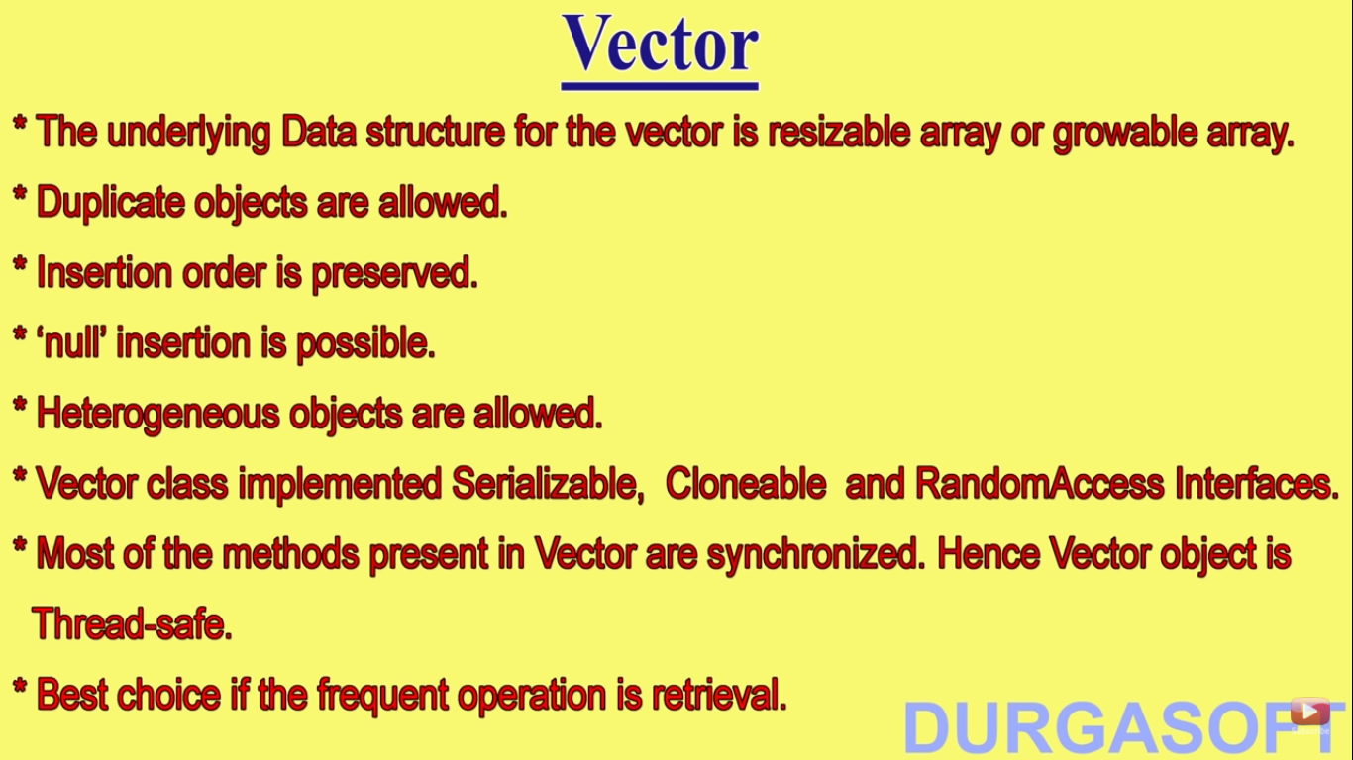
Vector

Slide 51
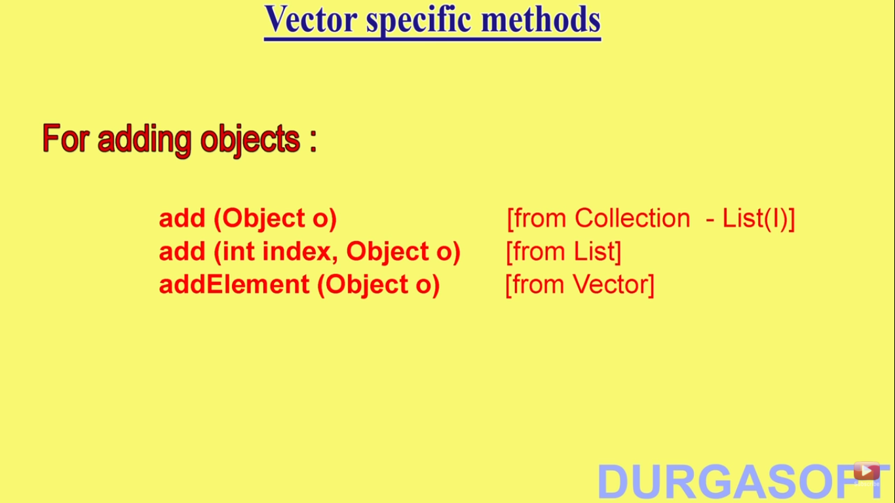
Method available in vector

Slide 52

Method in vector

Slide 53

Methods in vector

Slide 54

Constructor in vector

Slide 55

Capacity of a vector

Slide 56

stack

Slide 57

Constructor in stack

Slide 58

Methods in stack

Slide 59


Slide 60

Cursors

Slide 61

Enumeration cursor

Slide 62

Methods of enum

Slide 63

Program enum

Slide 64


Slide 65

Limitation of enum

Slide 66

iterator

Slide 67

iterator

Slide 68

Methods in iterator

Slide 69


Slide 70

Limitation of iterartor

Slide 71

listiterator

Slide 72

listiterator

Slide 73

Methods in listiterator

Slide 74


Slide 75

Limitation of listiterator

Slide 76

Diff btw enum, iterator & listiterator

Slide 77

Cursors implementation

Slide 78


Slide 79


Slide 80


Slide 81


Slide 82


Slide 83


Slide 84


Slide 85


Slide 86


Slide 87


Slide 88


Slide 89


Slide 90


Slide 91


Slide 92


Slide 93


Slide 94


Slide 95


Slide 96


Slide 97


Slide 98


Slide 99


Slide 100


Slide 101


Slide 102


Slide 103


Slide 104


Slide 105


Slide 106


Slide 107


Slide 108


Slide 109


Slide 110


Slide 111


Slide 112


Slide 113


Slide 114


Slide 115


Slide 116


